Slide 1
FERMI ENERGY LEVELS

Slide 2
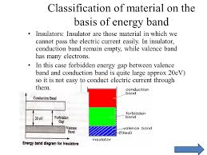
Classification of solids
Energy band of the material

Slide 3
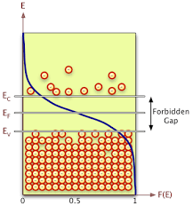
FORBIDDEN GAP

Slide 4
Absolute zero,Temp increased
FERMI ENERGY CHANGED

Slide 5
Classification of solids
Classification of materials based on forbidden gap
Forbidden gap plays a major role for determining the electrical conductivity of material. Based on the forbidden gap materials are classified in to three types, they are
Insulators
Conductors
semiconductors
Insulators

Slide 6
What is meant by insulator
The materials which does not allow the flow of electric current through them are called as insulators. Insulators are also called as poor conductors of electricity.

Slide 7
Forbidden band

Slide 8
Energy gap in insulators
in insulators the valence band is fully occupied with electrons due to sharing of outer most orbit electrons with the neighboring atoms. Where as conduction band is empty, I.e, no electrons are present in conduction band.
The forbidden gap between the valence band and conduction band is very large in insulators. The energy gap of insulator is approximately equal to 15 electron volts (eV).

Slide 9
Examples of insulators
in insulators, this is practically impossible to move the valence band electrons in to conduction band.
Rubber, wood, diamond, plastic are some examples of insulators. Insulators such as plastics are used for coating of electrical wires. These insulators prevent the flow of electricity to unwanted points and protect us from electric shocks.

Slide 10
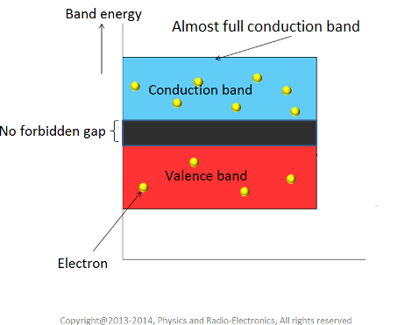

Slide 11
FERMI LEVEL
Fermi level" is the term used to describe the top of the collection of electron energy levels at absolute zero temperature. This concept comes from Fermi-Dirac statistics. Electrons are fermions and by the Pauli exclusion principle cannot exist in identical energy states.

Slide 12
Fermi level of solid state body
The Fermi level of a solid-state body is the thermodynamic work required to add one electron to the body. It is a thermodynamic quantity usually denoted by µ or EF for brevity.

Slide 13
FERMI DIRAC FUNCTION
The Fermi-Dirac distribution function, also called Fermi function, provides the probability of occupancy of energy levels by Fermions. Fermions are half-integer spin particles, which obey the Pauli exclusion principle.

Slide 14
FERMI DIRAC STATISTICS
n quantum statistics, a branch of physics, Fermi–Dirac statistics describe a distribution of particles over energy states in systems consisting of many identical particles that obey the Pauli exclusion principle. It is named after Enrico Fermi and Paul Dirac, each of

Slide 15
FERMI DIRAC FUNCTION

Slide 16
FERMI DIRAC STATISTICS
In quantum statistics, a branch of physics, Fermi–Dirac statistics describe a distribution of particles over energy states in systems consisting of many identical particles that obey the Pauli exclusion principle. It is named after Enrico Fermi and Paul Dirac, each of whom discovered the method independently.

Slide 18
The highest filled level, which separates the filled and empty levels at 0 K is known as the Fermi level and the energy corresponding to this level is called Fermi energy (E_{F}). Fermi energy can also be defined as the highest energy possessed by an electron in the material at 0 K. At 0 K, the Fermi energy E_{F} is represented as E_{F0}. As the temperature of the metal is increased from 0 K to TK, then those electrons which are present up to a depth ofK_{B}T from Fermi energy may take thermal energies equal to K_{B}T and occupy higher energy levels, whereas the electrons present in the lower energy levels i.e., below K_{B}T from Fermi level, will not take thermal energies because they will not find vacant electron states.

Slide 20
FERMI ENERGY vs ENERGY

Slide 21
The probability that a particular quantum state at energy E is filled with an electron is given by Fermi-Dirac distribution function f(E), given by:

Slide 22
Analytical Treatment At 0 K: Substitute T = 0 K in the Fermi-Dirac distribution, we have

Slide 23
This Photo by Unknown Author is licensed under CC BY-SA

Slide 24
The curve has step-like character with f(E) = 1 for energies below E_{F0} and f(E) = 0 for energies above E_{F0}. This represents that all the energy states below E_{F0} are filled with electrons and all those above it are empty.

Slide 25
At T is greater than 0k

Slide 26
As the temperature is raised from absolute zero to T₁K, the distribution curve begins to departs from step-like function and tails off smoothly to zero. Again with a further increase in temperature to T₂K and to T₃K, the departure and tailing of the curves increases. This indicates that more and more electrons may occupy higher energy states with an increase of temperature and as a consequence the number of vacancies below the Fermi level increases in the same proportion. At non-zero temperatures, all these curves pass through a point whose f(E) =1/2, at E = E_{F} . So E_{F} lies half way between the filled and empty states.

Slide 27
This Photo by Unknown Author is licensed under CC BY-SA

Slide 29
Distribution functions are nothing but the probability density functions used to describe the probability with which a particular particle can occupy a particular energy level. When we speak of Fermi-Dirac distribution function

Slide 30
Here, by fermions, we mean the electrons of an atom which are the particles with ½ spin, bound to Pauli exclusion principle.

Slide 31
Necessity of Fermi Dirac Distribution Function
In fields like electronics, one particular factor which is of prime importance is the conductivity of materials. This characteristic of the material is brought about the number of electrons which are free within the material to conduct electricity.

Slide 32
As per energy band theory (refer to the article “Energy Bands in Crystals” for more information), these are the number of electrons which constitute the conduction band of the material considered. Thus inorder to have an idea over the conduction mechanism, it is necessary to know the concentration of the carriers in the conduction band.

Slide 33
Fermi Dirac Distribution Expression
Mathematically the probability of finding an electron in the energy state E at the temperature T is expressed as

Slide 35
E=Ef is the Boltzmann constant T is the absolute temperature E_{f} is the Fermi level or the Fermi energy
Now, let us try to understand the meaning of Fermi level. In order to accomplish this, put

Slide 37
This means the Fermi level is the level at which one can expect the electron to be present exactly 50% of the time.

Slide 38
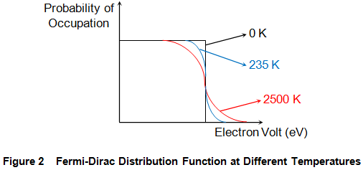
Effect of temperature on Fermi-Dirac Distribution Function

Slide 39
At T = 0 K, the electrons will have low energy and thus occupy lower energy states. The highest energy state among these occupied states is referred to as Fermi-level. This inturn means that no energy states which lie above the Fermi-level are occupied by electrons. Thus we have a step function defining the Fermi-Dirac distribution function as shown by the black curve in Figure 2.

Slide 40
However as the temperature increases, the electrons gain more and more energy due to which they can even rise to the conduction band. Thus at higher temperatures, one cannot clearly distinguish between the occupied and the unoccupied states as indicated by the blue and the red curves shown in Figure 2.

Slide 41
The Fermi-Dirac Distribution
The Fermi-Dirac distribution applies to fermions, particles with half-integer spin which must obey the Pauli exclusion principle. Each type of distribution function has a normalization term multiplying the exponential in the denominator which may be temperature dependent. For the Fermi-Dirac case, that term is usually written:

Slide 43
The significance of the Fermi energy is most clearly seen by setting T=0. At absolute zero, the probability is =1 for energies less than the Fermi energy and zero for energies greater than the Fermi energy. We picture all the levels up to the Fermi energy as filled, but no particle has a greater energy. This is entirely consistent with the Pauli exclusion principle where each quantum state can have one but only one particle.

Slide 46
This Photo by Unknown Author is licensed under CC BY-SA

Slide 47
